Slide 1
Beginner’s Introduction to Computing at CARC
Matthew Fricke
Version 0.1

Slide 2
Goals
1) Basic Linux Literacy
2) Ability to run programs on CARC compute nodes
I hope to spend about an hour on each with a 15 minute break.

Slide 3
Outline
High Performance Computing Overview
Logging in
The BASH Shell and Scripts
The Slurm Job Scheduler
Storage at CARC
Transferring data to and from CARC
Accessing software and the module system
Parallelization

Slide 4
High Performance Computing
What is high performance computing?
Really just means something that is a lot more powerful than your desktop or laptop.
Hardware:
That might mean more and faster processors to do the calculations more quickly (eg 400 CPUs instead of 4)
More RAM so you can work on bigger problems (3,000 GB instead of 8)
Bigger file systems so you can process larger datasets
More and bigger GPUs to accelerate your computations (12 GPUs at a time instead of 1)
People:
Someone else to manage the systems and keep them running and secure
Someone to answer your questions and help with problems

Slide 5

Logging into Wheeler
First login to the Linux workstation in front
of you.
Use your CARC username and password.
Keven, Tannor, and Jose can help you login if you have trouble.
This is an “important step” so don’t let me move on until you have logged in

Slide 6
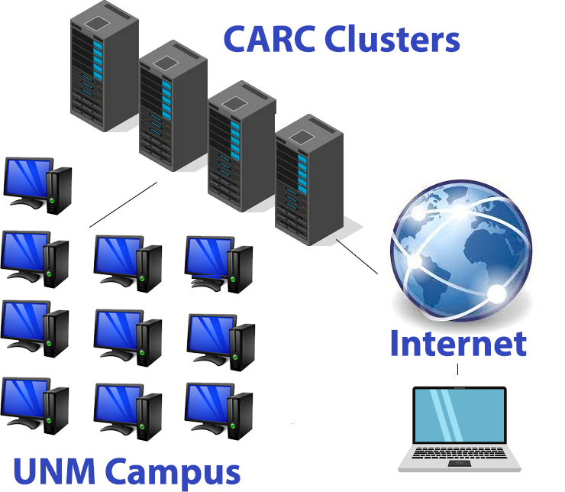
Logging into Wheeler
First login to the workstation in front of you.
You will always login to
CARC cluster remotely.
These clusters don’t even
have monitors.

Slide 7
Logging into Wheeler
We are going to use a program called secure shell.
Secure shell (ssh) is now built into every major operating system (Windows, OSX, and Linux).
You don’t need third party programs like putty anymore.

Slide 8
Logging into Wheeler
ssh mfricke@wheeler.alliance.unm.edu
Should prompt you for a password…
Don’t let me move on until you are able to login.

Slide 9
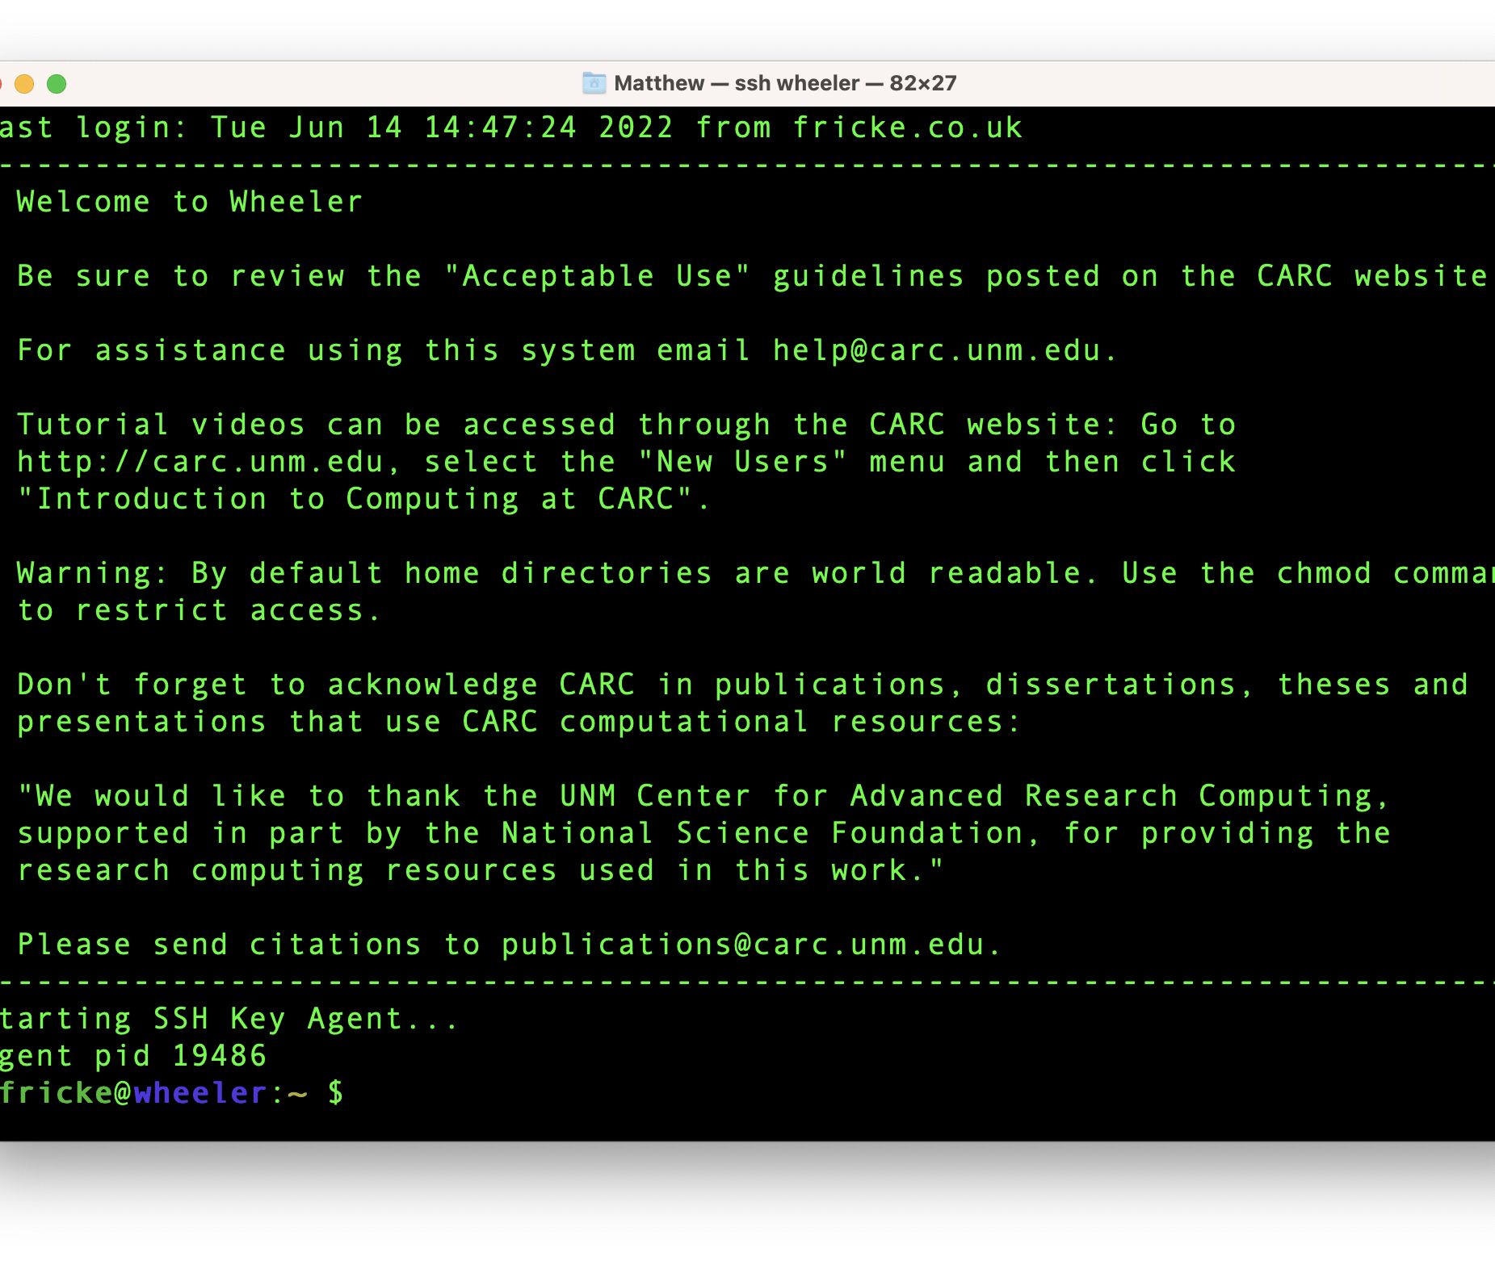
Logging into Wheeler

Slide 10
Please enter the following command
cp –r /projects/shared/workshops/beginner/mystuff ~/
We will come help you if you have any trouble.
(Later I will go over what this command does)

Slide 11
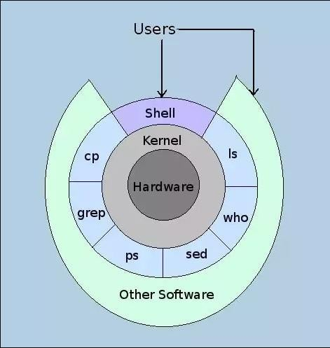
Linux and the BASH Shell
The Kernel manages access to the hardware in a computer.
An Operating System (OS) is the Kernel plus useful programs provided by the OS.
The “shell” is the outermost layer of the OS.
It is where the user interacts with the OS.
Notes:
A shell is the main interface for linux. You can enter commands here. The operating system (whether it is windows, Mac, or Linux) provides access to

Slide 12
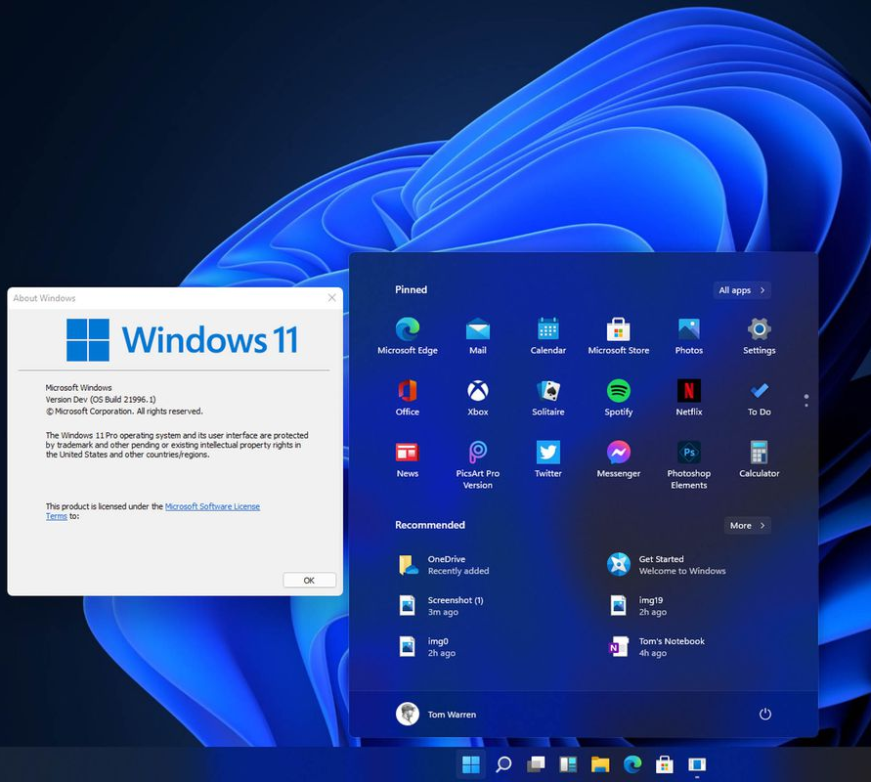
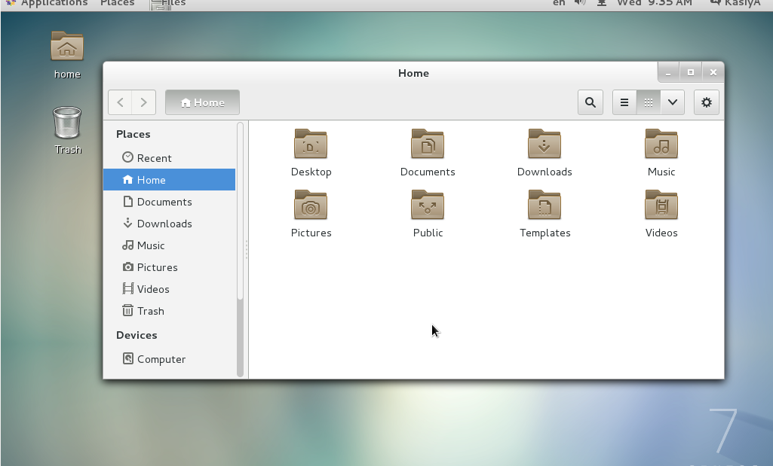
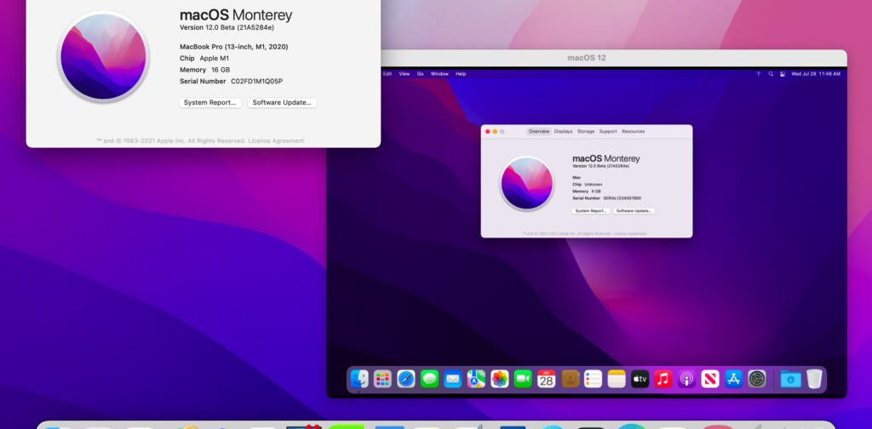
Graphical Shells (GUIs)
Notes:
Most operating systems offer Graphical User Interfaces. They designed to be intuitive and comfortable.

Slide 13
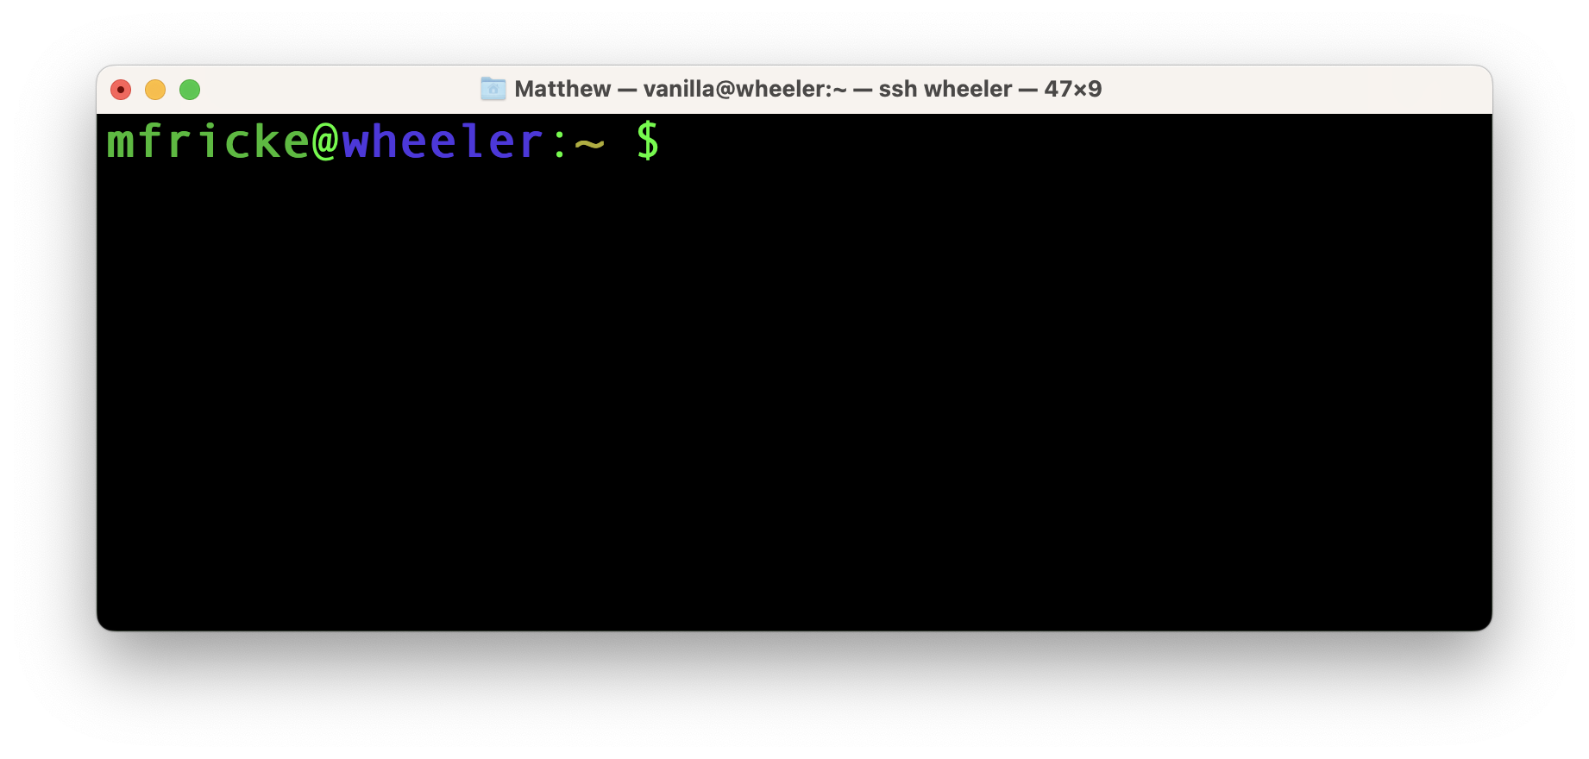
Logging into Wheeler
Notes:
In contrast to a nice friendly GUI the command line shell is pretty intimidating. You can type powerful and flexible commands here, but you have to know exactly what to type.

Slide 14


Slide 15

Linux and the BASH Shell
Notes:
The command line shell is much more powerful than a GUI because the actions are not predefined the way icons are. In Linux the command line is a big part of how you interact with the system. Partly that’s because Linux’s ancestor UNIX predates GUIs. It is also a lot easier to run a command line shell remotely than a GUI because a lot less data has to be transmitted over the network (modern fast networks make this less of a problem – but if you try to run a graphical program remotely you will definitely see it is far slower than you are used to). But mostly is is because you can do a lot more from the command line than from a GUI. Even Microsoft has been spending more time on command line shells (powershell) because users find them more powerful. The command line shell allows you to do very complicated things with just a few commands that you couldn’t do with a GUI. From a practical point-of-view, there are very few, if any graphical tools for running programs on an HPC system. No-one has been able to develop a GUI interface that works as well as the command line interface for that sort of task (and I’ve never even seen it attempted – except perhaps a program called Galaxy). Another reason is that people running programs on HPC centers tend to be programmers – and programmers love being able to type their commands. Chemistry, Physics have a long tradition of programming, but so do disciplines such as Psychology.

Slide 16
The Borne-Again Shell (BASH)
Written in 1976 by Stephen Bourne for UNIX version 7.
Notes:
Everything we do today, and most of what you do when working with CARC will be done using BASH. In the Mac terminal you will use BASH or Z-shell. On Windows, powershell. You can run graphical programs when needed from the command line shell. BASH assumes you know what you are doing and doesn’t offer a lot of help on the way. BUT helping you is Tannor, Kevin, and my job. So make use of us in office hours. If you are running on your own system you have to be careful – there are commands that can damage the software and data on your system. On CARC systems there are very few things you can do that will harm our systems – you can affect your own data and software – but don’t worry that you are going to do anything to hurt the CARC systems.

Slide 17
Understanding the BASH prompt…
Username
Notes:
In Linux data and programs are always organized into files and directories. So the first command you will learn is “ls” which stands for list storage.

Slide 18
Understanding the BASH prompt…
Username
Hostname
Notes:
The hostname is the name of the network name of the computer you are logged into

Slide 19
Understanding the BASH prompt…
This is the current working directory.
“~” is short for home directory
Notes:
A directory tree is the same concept in Windows and OSX.

Slide 20
Understanding the BASH prompt…
“$” means this user is standard user
(i.e. not a system administrator)
Notes:
If the account had administrator rights it would have a hash # at the end.

Slide 21
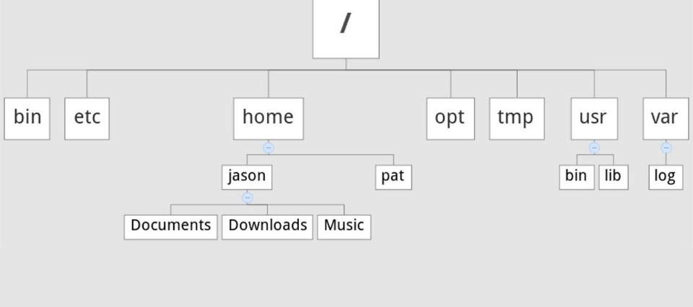
Example Filesystem Tree
Notes:
Just like in Windows and OS X files and directories are organized into a “tree”. Computer scientists don’t usually get out much and so are botanically challenged. The tree is upside down with the “root” of the tree at the top. It is indicated by the forward slash “/”. This is the layout of a typical linux system given just as an example. A linux system can have multiple filesystems each with its own root. Everything I am saying here also applied to Macs because the OS that Macs use is a very close cousin of Linux. The only difference with windows is that the root of filesystems are either a letter and a colon like “C:” or a double back-slash “\\”. The linux approach is that “everything” is a file. Directories are just files that contain more files, some of which might be programs, others might have data in them, and some might be directories that store more files. By the way directories and folders are synonymous. It’s old fashioned now but the idea was that the filesystem is like a filing cabinet. The folders inside are directories, and the documents are kept ”on file”.

Slide 22
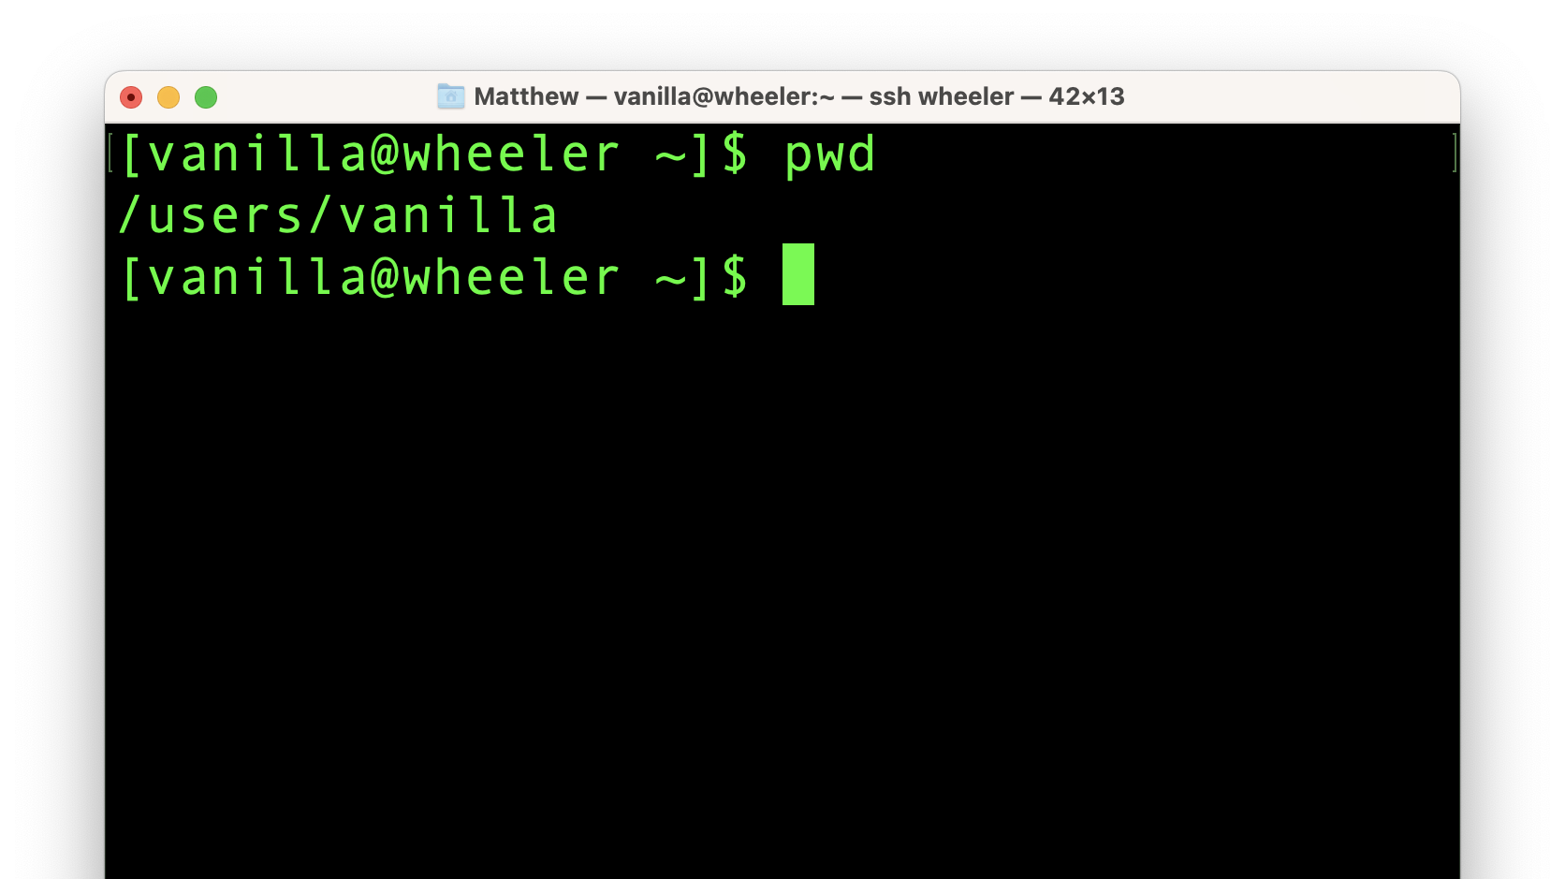
Figuring out where you are in the filesystem…
Notes:
The first command you are going to enter is “pwd” which stands for “print working directory”. In linux the working directory is the directory you are currently in. When you enter a command in BASH the command runs and then the prompt is printed again. In linux “no news is good news” commands try to print as little as possible unless there is a problem. So the current directory is /users/vanilla. Directory and file paths are formatted with names separated by forward slashes “/” just as in Mac. Windows uses “\” back slashes. The leading forward slash “/” always means the root of a filesystem. So in this last the “path” to the current working directory is “root, users, vanilla”.

Slide 23
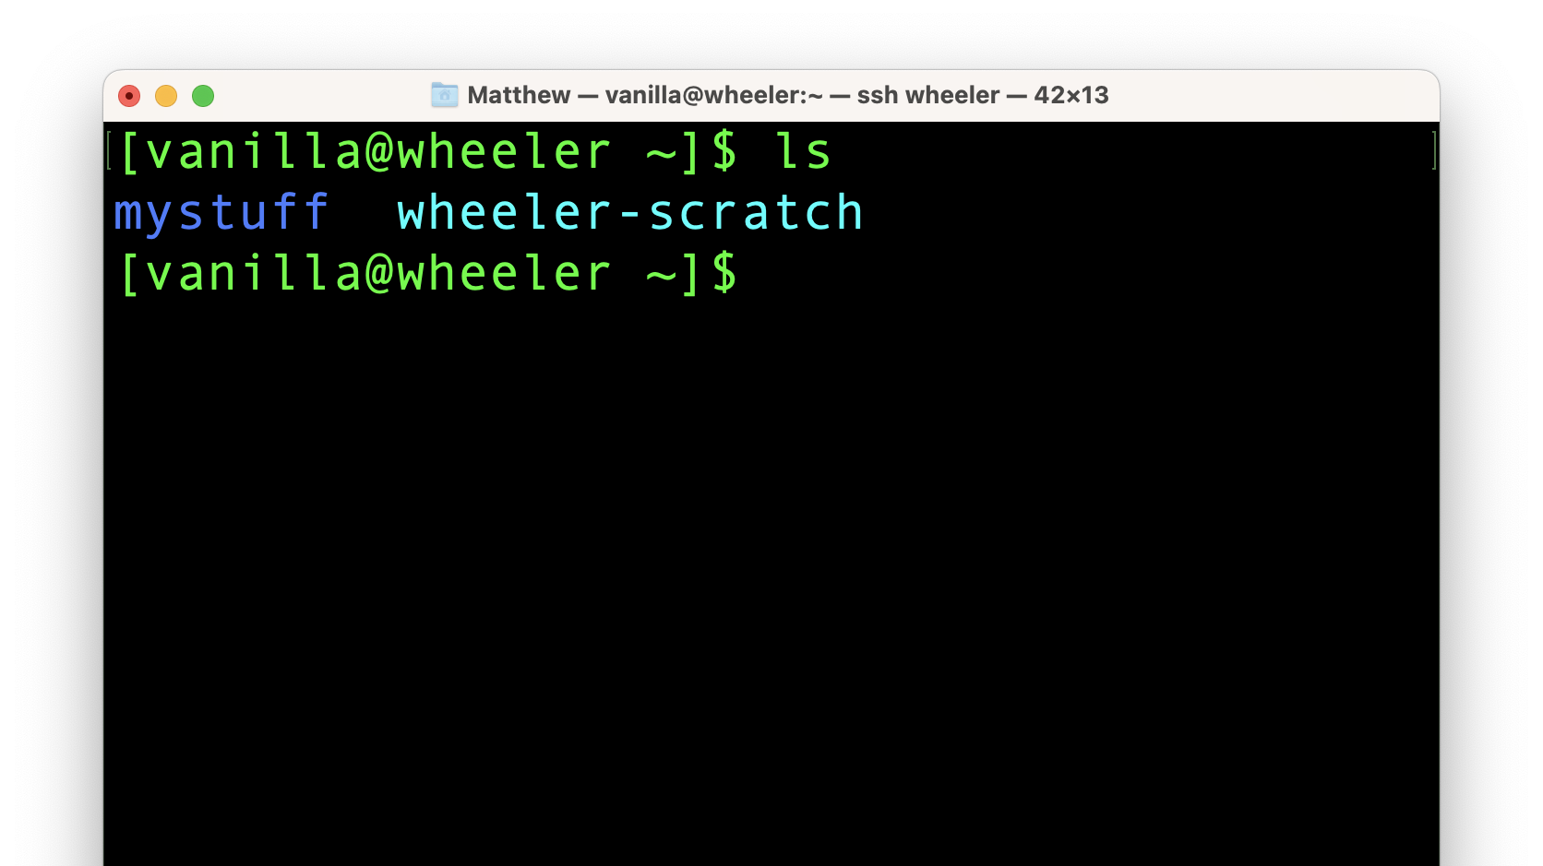
Figuring out where you are in the filesystem…
Notes:
This next command is “ls” which stands for “list storage”. “ls” is probably the command you will enter the most when you are working in linux. So the command shows that there are two things in the home directory. One is a directory names “mystuff” and the other is a “link” or “shortcut” to another filesystem.

Slide 24
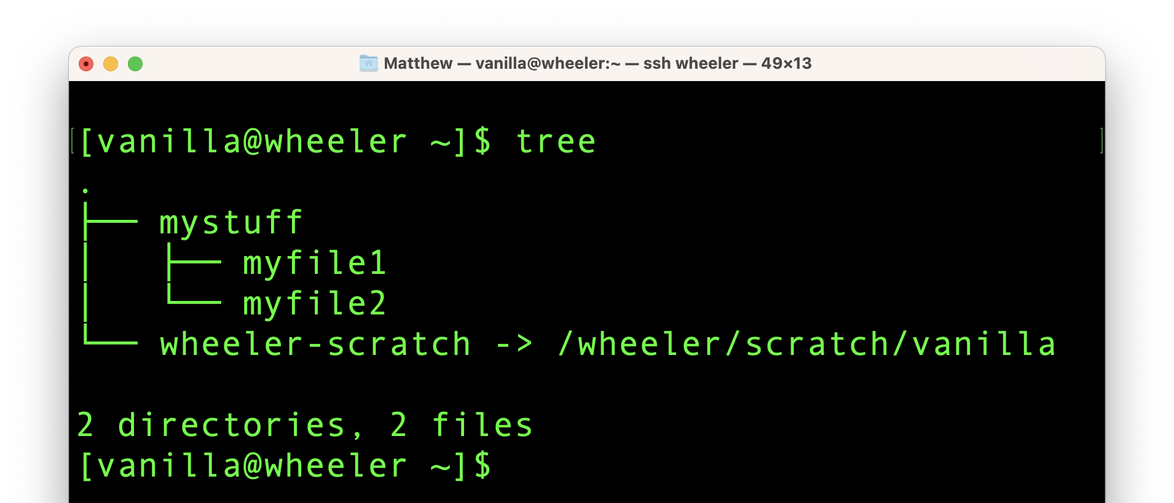
Figuring out where you are in the filesystem…
Notes:
“Tree” is a much less commonly used command but it prints the “directory tree”. Here we can see that the mystuff directory contains two files “myfile1” and “myfile2”. It also shows that the “wheeler-scratch” link goes to another file system. The leading “/” shows that the /wheeler/scratch/vanilla path is a complete path.

Slide 25
Figuring out where you are in the filesystem…
Notes:
“Tree” is a much less commonly used command but it prints the “directory tree”. Here we can see that the mystuff directory contains two files “myfile1” and “myfile2”. It also shows that the “wheeler-scratch” link goes to another file system. The leading “/” shows that the /wheeler/scratch/vanilla path is a complete path.

Slide 26
This . means the current directory
Figuring out where you are in the filesystem…
Notes:
“Tree” is a much less commonly used command but it prints the “directory tree”. Here we can see that the mystuff directory contains two files “myfile1” and “myfile2”. It also shows that the “wheeler-scratch” link goes to another file system. The leading “/” shows that the /wheeler/scratch/vanilla path is a complete path.

Slide 27
“Absolute” paths vs “relative” paths
A path is a list of directories and/or files. It is a path through the directory tree that tells one how to get somewhere in the filesystem.
An absolute path tells one how to get to the destination from starting from the root of the filesystem. E.g “/users/vanilla/mystuff/”
A relative path specifies how to get there *starting from the current working directory*. E.g vanilla/mystuff/

Slide 28
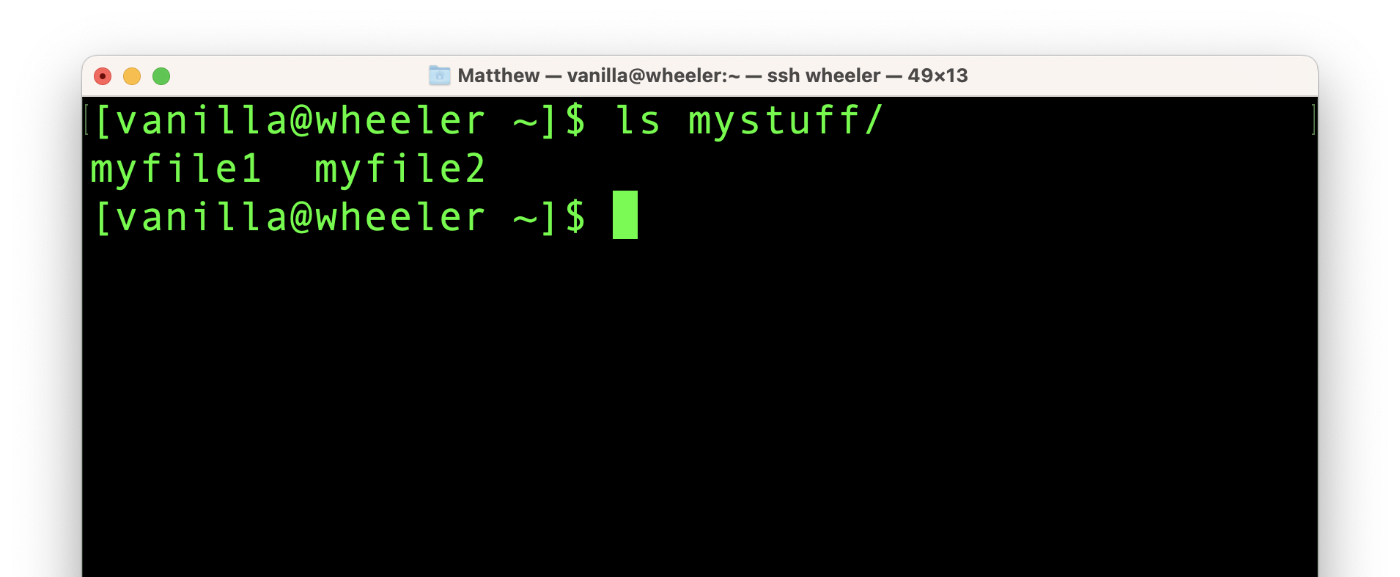
Figuring out where you going…
Notes:
Let’s go back to the “ls” command. I am running “ls” with an “argument” an argument is just some text that comes after a command or program. If I don’t give “ls” an an argument then it defaults to listing the contents of the current directory. But I can give “ls” a path and ask it to list the contents of that path. Here I gave it a relative path (notice there is no leading forward slash “/”).

Slide 29
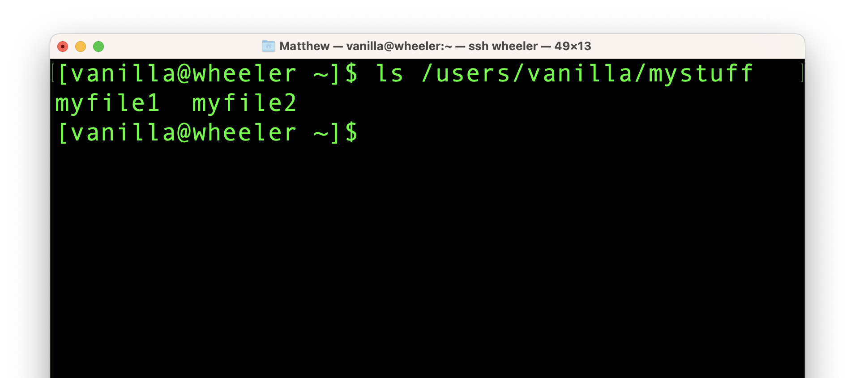
Figuring out where you going…
Notes:
Here is the same command but the argument uses the full or absolute path.

Slide 30
[vanilla@wheeler ~]$ ls ./mystuff/
myfile1 myfile2
[vanilla@wheeler ~]$ ls ~/mystuff/
myfile1 myfile2
[vanilla@wheeler ~]$
Figuring out where you going…
Notes:
And here are two more ways to give the path to “mystuff”. The first gives the relative path but explicitly includes the “.” which means the current directory. The second uses the “~” which means “my home directory”.

Slide 31
[vanilla@wheeler ~]$ ls -a
. .modulesbeginenv
.. mystuff
.addressbook .oracle_jre_usage
.addressbook.lu .pinerc
.bashrc .pki
.cache .rhosts
.comsol .shosts
.config .spack
.flexlmrc .ssh
Figuring out where you going…
Notes:
Here we give ls a different argument. This argument starts with a dash. That usually means that the argument is an option being given to the program. In this case “-a” means show all contents of this directory. Linux hides files and directories by adding a ”.” to the beginning of the file names. Almost always linux hides these files from you for a reason. Linux doesn’t want you to worry about these in the course of your regular work. They are often configuration files for example for programs you might have run.

Slide 32
[vanilla@wheeler ~]$ ls -l
total 4
drwxr-xr-x 2 vanilla users 4096 Jun 14 22:05 mystuff
lrwxrwxrwx 1 vanilla users 24 Jun 14 21:20 wheeler-scratch -> /wheeler/scratch/vanilla
[vanilla@wheeler ~]$
Figuring out where you going…
Notes:
BTW – you might be getting tired of looking at ways to list files by this point. But remember that in linux “everything” is a file. So these tools are critical to getting around and using the system. Here we give “ls” a different option. “-l” tells ls to print information using the long format. Now we can see information like when the the file was last changed, the size of the file, where links go, etc. The drwx etc determine who can read, write, and execute the files.

Slide 33
[vanilla@wheeler ~]$ ls -l mystuff/
total 473704
-rw-r--r-- 1 vanilla users 483165473 Jun 14 23:20 myfile1
-rw-r--r-- 1 vanilla users 0 Jun 14 22:05 myfile2
[vanilla@wheeler ~]$
Figuring out where you going…
Notes:
Now we can start combining arguments to the “ls” program. Here we use “-l” and give a path.

Slide 34
[vanilla@wheeler ~]$ ls -lh mystuff/
total 463M
-rw-r--r-- 1 vanilla users 461M Jun 14 23:20 myfile1
-rw-r--r-- 1 vanilla users 0 Jun 14 22:05 myfile2
[vanilla@wheeler ~]$
Figuring out where you going…
Notes:
Wildcards

Slide 35
[vanilla@wheeler ~]$ du -s
499704 .
[vanilla@wheeler ~]$ du -sh
488M .
[vanilla@wheeler ~]$
Figuring out where you going…
Notes:
The “du” command shows “disk usage” of the directory tree. If you give it no arguments it starts in the current directory. The “-s” option asks for the summary (i.e. total) usage. And as with ls “h” asks for the size in human friendly format.

Slide 36
[vanilla@wheeler ~]$ df -h
Filesystem Size Used Avail Use% Mounted on
devtmpfs 24G 0 24G 0% /dev
tmpfs 24G 64K 24G 1% /dev/shm
tmpfs 24G 968M 23G 5% /run
tmpfs 24G 0 24G 0% /sys/fs/cgroup
/dev/mapper/centos-root 930G 567G 363G 61% /
/dev/sdc2 836G 72G 764G 9% /tmp
/dev/md126p1 2.0G 333M 1.7G 17% /boot
172.17.2.254:/mnt/wheeler-scratch 37T 28T 8.7T 77% /wheeler/scratch
172.17.2.255:/mnt/wheeler-scratch2 37T 28T 9.0T 76% /wheeler/scratch2
beegfs_nodev 110T 51T 60T 46% /carc/scratch
chama:/home/homes 65T 36T 30T 55% /users
chama:/home/carc_projects 65T 36T 30T 55% /projects
Figuring out where you going…
Notes:
The “df” or “disk free” command shows you information about all the filesystems on this computer. You don’t need to worry to much about these filesystems since we manage them for you. We worry a lot about how full they are getting but this is summary information for all the users of Wheeler.

Slide 37
[vanilla@wheeler ~]$ quota -s
Disk quotas for user vanilla (uid 659):
Filesystem space quota limit grace files quota limit grace
chama:/home/homes
488M 100G 200G 315 4295m 4295m
[vanilla@wheeler ~]$
Figuring out where you going…
Notes:
This is the number you do have to care about. We limit the amount of storage you have in your home directory so noone can use it all up. Everyone get the same amount of home directory storage. There are other filesystems such as scratch space where the quota is 1 TB. In your home directory the storage is limited to 200GB. The only numbers that matter are in the “Space” column which show how much you have used, and the “limit” column which shows how much you are allowed to use. If space exceeds limit then you won’t be able to write any more data to your home directory.

Slide 38
[vanilla@wheeler ~]$ stat mystuff/myfile1
File: ‘mystuff/myfile1’
Size: 483165473 Blocks: 947408 IO Block: 65536 regular file
Device: 28h/40d Inode: 9232782834205560540 Links: 1
Access: (0644/-rw-r--r--) Uid: ( 659/ vanilla) Gid: ( 100/ users)
Access: 2022-06-14 22:05:27.503289000 -0600
Modify: 2022-06-14 23:20:26.945918000 -0600
Change: 2022-06-14 23:20:48.754917000 -0600
Birth: -
Figuring out what you’ve got…
Notes:
The cd or “change directory” command allows you to change the current working directory to whatever path, absolute or relative that comes next.

Slide 39
[vanilla@wheeler ~]$ find -name myfile2
./mystuff/myfile2
[vanilla@wheeler ~]$ find -name "myfile*"
./mystuff/myfile1
./mystuff/myfile2
./mystuff/myfile3
./mystuff/myfile0
Wildcard
Figuring out what you’ve got…
Notes:
The find command. Searches from the current directory through the tree recursively and returns the relative path to the file if it exists. Wildcards can be given to all the commands you have seen – then the command is applied to just filenames that match the pattern with anything substituted for the wildcard.

Slide 40
[vanilla@wheeler ~]$ cd mystuff/
[vanilla@wheeler ~/mystuff]$
Use the tab key to autocomplete
Going somewhere new…
Notes:
The cd or “change directory” command allows you to change the current working directory to whatever path, absolute or relative that comes next.

Slide 41
Now it is your turn…
For this path: /projects/shared/workshops/beginner/vecadd
What are the names of the files in that directory?
When were they last modified?
How large are the files?
You can find this information with the ls command.

Slide 42
Now it is your turn…
For this path: /projects/shared/workshops/beginner/vecadd
Now “cd” into that directory using <tab> autocomplete.

Slide 43
Now you know how to find your way around filesystems using bash
Let’s see how to modify the filesystem.
In bash to move a file we use the mv command.
To copy a file it is cp.
To copy files from CARC to a personal computer use scp or rsync.

Slide 44
[vanilla@wheeler beginner]$ pwd
/projects/shared/workshops/beginner
[vanilla@wheeler beginner]$ cd ~
[vanilla@wheeler ~]$ pwd
/users/vanilla
[vanilla@wheeler ~]$
First return to your home directory…
Notes:
The cd or “change directory” command allows you to change the current working directory to whatever path, absolute or relative that comes next.

Slide 45
[vanilla@wheeler ~]$ cd mystuff
[vanilla@wheeler ~/mystuff]$ mv myfile1 myfile0
[vanilla@wheeler ~/mystuff]$ ls
myfile0 myfile2 myfile3
[vanilla@wheeler ~/mystuff]
Modifying the filesystem… moving a file.
Notes:
The cd or “change directory” command allows you to change the current working directory to whatever path, absolute or relative that comes next.

Slide 46
[vanilla@wheeler ~/mystuff]$ cp myfile0 myfile1
[vanilla@wheeler ~/mystuff]$
Source
Destination
[vanilla@wheeler ~/mystuff]$ ls
myfile0 myfile1 myfile2 myfile3
[vanilla@wheeler ~/mystuff]$
Modifying the filesystem… copying a file.
Notes:
This pattern of the source path being on the left and the destination on the right is repeated for lots of commands.

Slide 47
[vanilla@wheeler ~/mystuff]$ mkdir mynewdir
[vanilla@wheeler ~/mystuff]$
New directory name
Modifying the filesystem… create a new directory.
Notes:
This pattern of the source path being on the left and the destination on the right is repeated for lots of commands.

Slide 48
[vanilla@wheeler ~]$ cp -r mystuff mystuff2
[vanilla@wheeler ~]$
Source
Destination
[vanilla@wheeler ~]$ ls
mystuff mystuff2 wheeler-scratch
Copying a whole directory tree…
Notes:
The “-r” option stands for “recursive”. In the BASH shell recursive usually means apply the command to everything in the directory tree starting at the path provided.

Slide 49
[vanilla@wheeler ~]$ exit
Lycaon:~ matthew$ scp vanilla@wheeler.alliance.unm.edu:~/mystuff/myfile3 Desktop/
(vanilla@wheeler.alliance.unm.edu) Password:
myfile3 100% 40 2.0KB/s 00:00
Source
Destination
Copying data to a personal computer from CARC…
Notes:
The “scp” commad which stands for secure copy is used to copy between computers – just like ssh is used to connect to remote computers. The “-r” option stands for “recursive”. In the BASH shell recursive usually means apply the command to everything in the directory tree starting at the path provided.

Slide 50
Lycaon:~ matthew$ scp -r vanilla@wheeler.alliance.unm.edu:~/mystuff Desktop/
(vanilla@wheeler.alliance.unm.edu) Password:
myfile1 100% 1024KB 6.5MB/s 00:00
myfile2 100% 2048KB 382.5KB/s 00:05
myfile3 100% 40 3.2KB/s 00:00
myfile0 100% 1024KB 8.8MB/s 00:00
Source
Destination
Copying data to a personal computer from CARC…
Notes:
The “-r” option stands for “recursive”. In the BASH shell recursive usually means apply the command to everything in the directory tree starting at the path provided.

Slide 51
Lycaon:~ matthew$ scp -r Desktop/mystuff vanilla@wheeler.alliance.unm.edu:~/
(vanilla@wheeler.alliance.unm.edu) Password:
myfile1 100% 1024KB 591.5KB/s 00:01
myfile0 100% 1024KB 2.0MB/s 00:00
myfile2 100% 2048KB 2.1MB/s 00:00
myfile3 100% 40 2.1KB/s 00:00
Source
Destination
To copy from a personal computer to CARC…
Notes:
All we have to do is reverse the order of the source and destination

Slide 52
ssh vanilla@wheeler.alliance.unm.edu
Log back into wheeler…
Notes:
All we have to do is reverse the order of the source and destination

Slide 53
[vanilla@wheeler ~]$ file mystuff/myfile0
mystuff/myfile0: data
[vanilla@wheeler ~]$ file mystuff/myfile3
mystuff/myfile3: ASCII text
Figuring out file types …
Notes:
The first step before editing a file is to determine what kind of file it is. Trying to open a large data file with a text editor would cause problems. Often people give their files an extension to give you a hint at what's in it. But linux does not require file extentions the way Mac and Windows sometimes do. Instead we can use a program called “file” to see what kind of file something is. The first file is a data file so we don’t want to edit it without a special program designed to handle it. Sometimes ”file” will tell you what that program is. The second file listed is an ACSII text file. BASH has lots of tools to help us work with text files.

Slide 54
[vanilla@wheeler ~]$ cat mystuff/myfile3
Welcome to the CARC Beginner's Workshop
Text files …
Notes:
The most common type of file you will come across in linux are plain text files. When we get to running jobs on the compute nodes we will write text files to define the jobs and read text files to get the results. If we want to display the contents of a file we can use the “cat” command if it is short or “less” if it is longer than one page. There are lots of text editors available on linux. Nano is the simplest when you are just getting started. More advanced editors commonly used are “vi” and “emacs”.

Slide 55
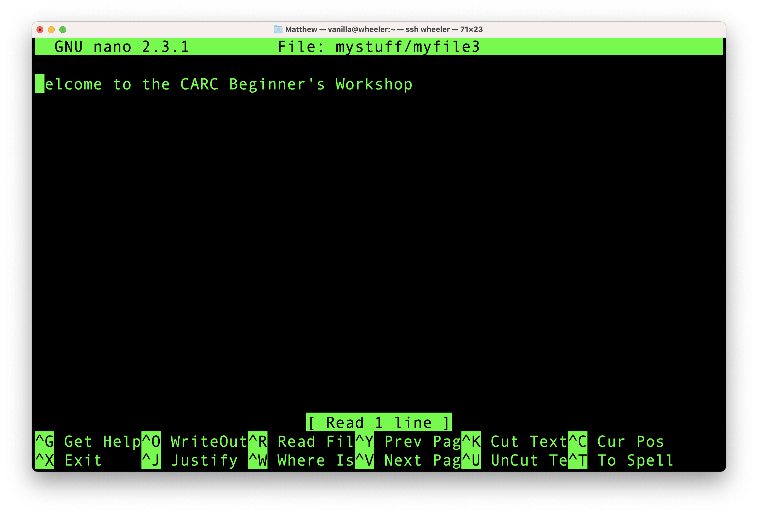
[vanilla@wheeler ~]$ nano mystuff/myfile3
Notes:
Command line text editors almost look like they have a GUI insterface. But you won’t be able to use the mouse to navigate only the keyboard.

Slide 56
[vanilla@wheeler ~]$ date
Wed Jun 15 03:08:15 MDT 2022
[vanilla@wheeler ~]$ echo Hello from $HOSTNAME
Hello from wheeler
[vanilla@wheeler ~]$ hostname
wheeler
Programs we will use as examples…

Slide 57
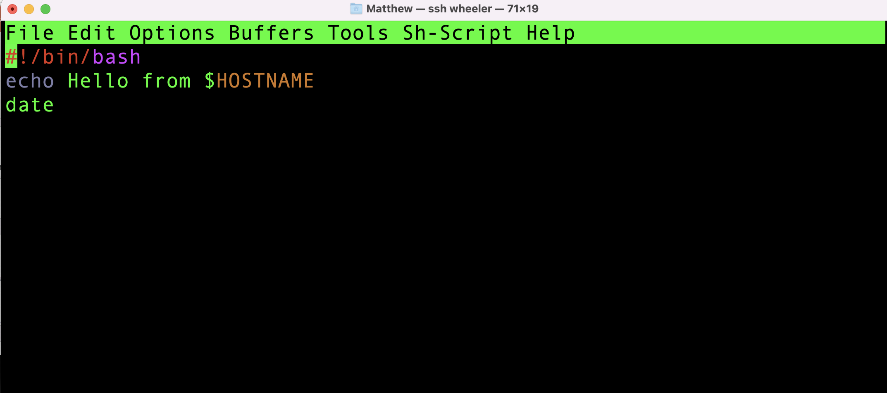
Shell Scripts

Slide 58
15 Minute Break

Slide 59
Software Access
Lmod Modules
Conda

Slide 60
[vanilla@wheeler ~]$ module spider matlab
----------------------------------------------------------------------------
matlab:
----------------------------------------------------------------------------
Versions:
matlab/R2017a
matlab/R2018b
matlab/R2019a
matlab/R2020a
matlab/R2021a
Getting access to software…

Slide 61
[vanilla@wheeler ~]$ module load matlab/R2021a
Lmod has detected the following error: Matlab may only be run on compute
nodes. wheeler is not a compute node. Exiting...
While processing the following module(s):
Module fullname Module Filename
--------------- ---------------
matlab/R2021a /opt/local/modules/matlab/R2021a.lua
Getting access to software…

Slide 62
[vanilla@wheeler ~]$ module load matlab/R2021a
Lmod has detected the following error: Matlab may only be run on compute
nodes. wheeler is not a compute node. Exiting...
While processing the following module(s):
Module fullname Module Filename
--------------- ---------------
matlab/R2021a /opt/local/modules/matlab/R2021a.lua
What is a compute node?
Getting access to software…

Slide 63

HPC Cluster

Slide 64
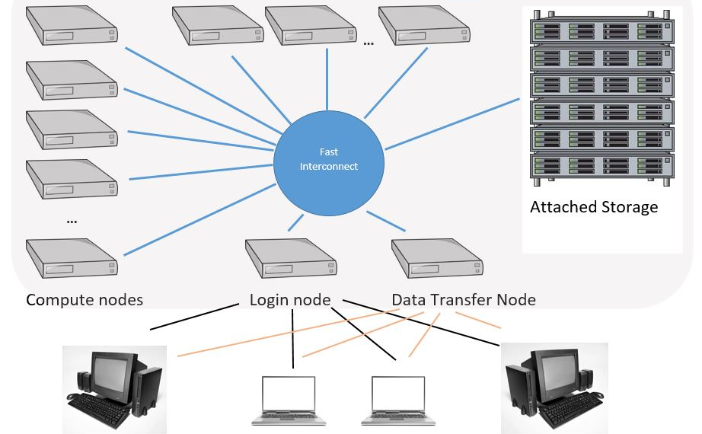
Head Node
Personal
Computer

Slide 65
Head Node
Personal
Computer

Slide 66
Head Node
Personal
Computer

Slide 67

Never run computations on the head node
Always use compute nodes

Slide 68
[vanilla@wheeler ~]$ qgrok
queues free busy offline jobs nodes CPUs
----- ----- ----- ----- ----- ----- -----
normal 0 299 1 97 300 2400
debug 4 0 0 0 4 32
totals: 4 299 1 97 304 2432
Compute nodes and partitions…

Slide 69
qmfricke@hopper:~ $ qgrok
queues free busy offline jobs nodes CPUs
----- ----- ----- ----- ----- ----- -----
general 12 0 0 0 12 384
condo 29 1 7 0 37 1184
bugs 2 0 0 0 2 64
pcnc 2 0 0 0 2 64
pathogen 0 1 0 1 1 32
tc 7 0 3 0 10 320
gold 2 0 0 0 2 64
fishgen 1 0 0 0 1 32
neuro-hsc 13 0 1 0 14 448
cup-ecs 2 0 0 0 2 64
tid 0 0 1 0 1 32
biocomp 0 0 1 0 1 32
chakra 0 0 1 0 1 32
totals: 70 2 14 1 86 2752
Compute nodes and partitions…

Slide 70
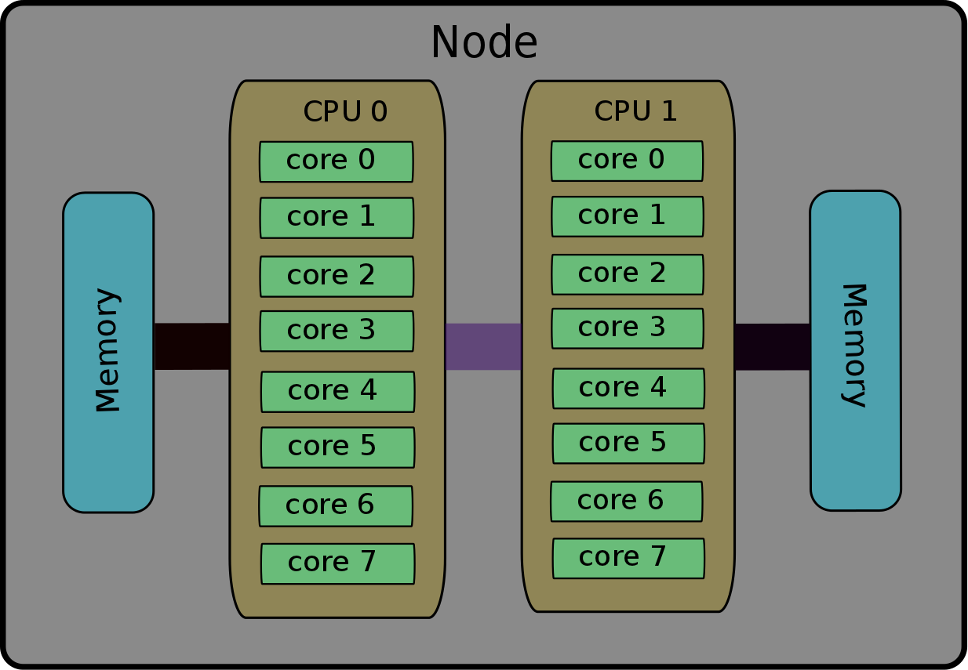
Notes:
Each node (just another name for a computer) has CPUs. Each CPU has many cores. Your

Slide 71
Head Node (wheeler)
Compute Nodes
…
wheeler001
wheeler002
wheeler304
Notes:
The head node is just for editing files, compiling programs if you write your own, and sending computations to the compute nodes.

Slide 72
[vanilla@wheeler ~]$ lscpu
Architecture: x86_64
CPU op-mode(s): 32-bit, 64-bit
Byte Order: Little Endian
CPU(s): 8
On-line CPU(s) list: 0-7
Thread(s) per core: 1
Core(s) per socket: 4
Socket(s): 2
NUMA node(s): 2
Vendor ID: GenuineIntel
CPU family: 6
Model: 26
Model name: Intel(R) Xeon(R) CPU X5550 @ 2.67GHz
Wheeler has 8 cores per node….
Notes:
The workstations in front of you have one CPU with 4 cores.

Slide 73
mfricke@hopper:~ $ lscpu
Architecture: x86_64
CPU op-mode(s): 32-bit, 64-bit
Byte Order: Little Endian
CPU(s): 64
On-line CPU(s) list: 0-63
Thread(s) per core: 2
Core(s) per socket: 16
Socket(s): 2
NUMA node(s): 2
Vendor ID: GenuineIntel
CPU family: 6
Model: 85
Model name: Intel(R) Xeon(R) Gold 6226R CPU @ 2.90GHz
Hopper has 32 real cores (64 virtual cores) per node….

Slide 74
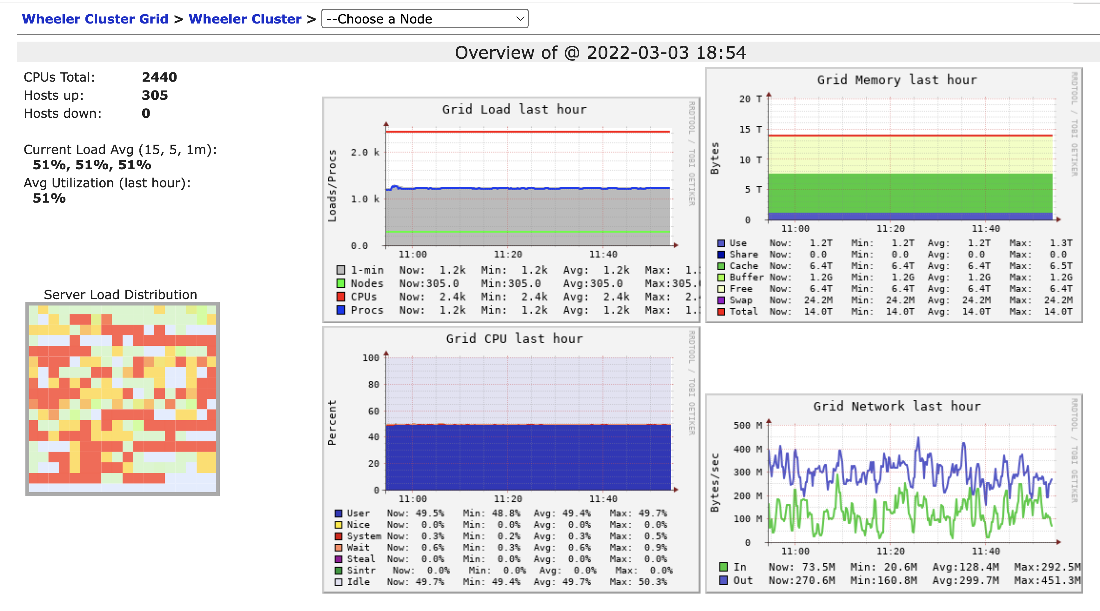
Architecture

Slide 75
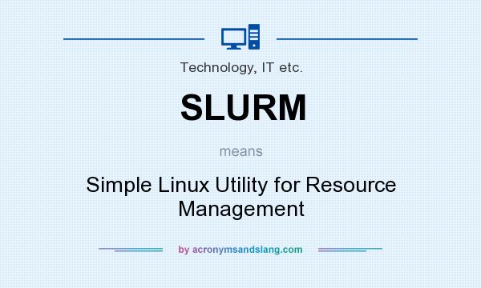

Slide 76

Notes:
Really the developers just liked the TV show Futurama

Slide 77
[vanilla@wheeler ~]$ squeue
JOBID PARTITION NAME USER ST TIME NODES NODELIST(REASON)
159914 normal co-mcpdf nsharma2 CG 2-00:00:26 1 wheeler257
159915 normal co-mcpdf nsharma2 CG 2-00:00:26 1 wheeler257
159916 normal co-mcpdf nsharma2 CG 2-00:00:26 1 wheeler257
159917 normal co-mcpdf nsharma2 CG 2-00:00:26 1 wheeler257
159918 normal co-mcpdf nsharma2 CG 2-00:00:26 1 wheeler257
159919 normal co-mcpdf nsharma2 CG 2-00:00:26 1 wheeler257
159912 normal co-mcpdf nsharma2 CG 2-00:00:28 1 wheeler257
159913 normal co-mcpdf nsharma2 CG 2-00:00:28 1 wheeler257
166800_[21-100%10] normal Jannat jannat PD 0:00 1 (JobArrayTaskLimit)
167067 normal WINDENER rubeldas PD 0:00 36 (QOSMaxCpuPerUserLimit)
167068 normal WINDENER rubeldas PD 0:00 24
Slurm….

Slide 78
[vanilla@wheeler ~]$ srun --partition debug --nodes 2 hostname
srun: Account not specified in script or ~/.default_slurm_account, using latest project
wheeler302.alliance.unm.edu
You have not been allocated GPUs. To request GPUs, use the -G option in your submission script.
wheeler301.alliance.unm.edu
[vanilla@wheeler ~]$ srun --partition debug --nodes 2 hostname
The srun command…

Slide 79

We finally used the HPC Cluster!

Slide 80
[vanilla@wheeler ~]$ srun --partition debug --nodes 2 hostname
srun: Account not specified in script or ~/.default_slurm_account, using latest project
wheeler302.alliance.unm.edu
You have not been allocated GPUs. To request GPUs, use the -G option in your submission script.
wheeler301.alliance.unm.edu
[vanilla@wheeler ~]$ srun --partition debug --nodes 2 hostname
The srun command…

Slide 81
[vanilla@wheeler ~]$ srun --partition debug --ntasks 8 hostname
srun: Account not specified in script or ~/.default_slurm_account, using latest project
wheeler302.alliance.unm.edu
wheeler302.alliance.unm.edu
wheeler302.alliance.unm.edu
wheeler302.alliance.unm.edu
wheeler302.alliance.unm.edu
wheeler302.alliance.unm.edu
You have not been allocated GPUs. To request GPUs, use the -G option in your submission script.
wheeler302.alliance.unm.edu
wheeler302.alliance.unm.edu
The srun command…
Notes:
The output of the hostname command is just the name of the compute node it ran on. Using srun like this is like running a command or program in the shell. This is an easy way to run lots of copies of your program in parallel.

Slide 82
[vanilla@wheeler ~]$ cp -r /projects/shared/workshops/beginner/vecadd ~
[vanilla@wheeler ~]$
Review, what does this command do?
Notes:
The output of the hostname command is just the name of the compute node it ran on. Using srun like this is like running a command or program in the shell. This is an easy way to run lots of copies of your program in parallel.

Slide 83
[vanilla@wheeler ~]$ cd vecadd/
[vanilla@wheeler ~/vecadd]$ module load openmpi/4.1.2-q2zi
What do these commands do?
Notes:
The output of the hostname command is just the name of the compute node it ran on. Using srun like this is like running a command or program in the shell. This is an easy way to run lots of copies of your program in parallel.

Slide 84
[vanilla@wheeler ~/vecadd]$ srun --partition debug --ntasks 4 vecaddmpi
Now run the program with “srun”…
Notes:
The output of the hostname command is just the name of the compute node it ran on. Using srun like this is like running a command or program in the shell. This is an easy way to run lots of copies of your program in parallel.

Slide 85
[vanilla@wheeler ~]$ qgrok
queues free busy offline jobs nodes CPUs
----- ----- ----- ----- ----- ----- -----
normal 0 299 1 97 300 2400
debug 4 0 0 0 4 32
totals: 4 299 1 97 304 2432
srun is good but HPC centers are busy!

Slide 86
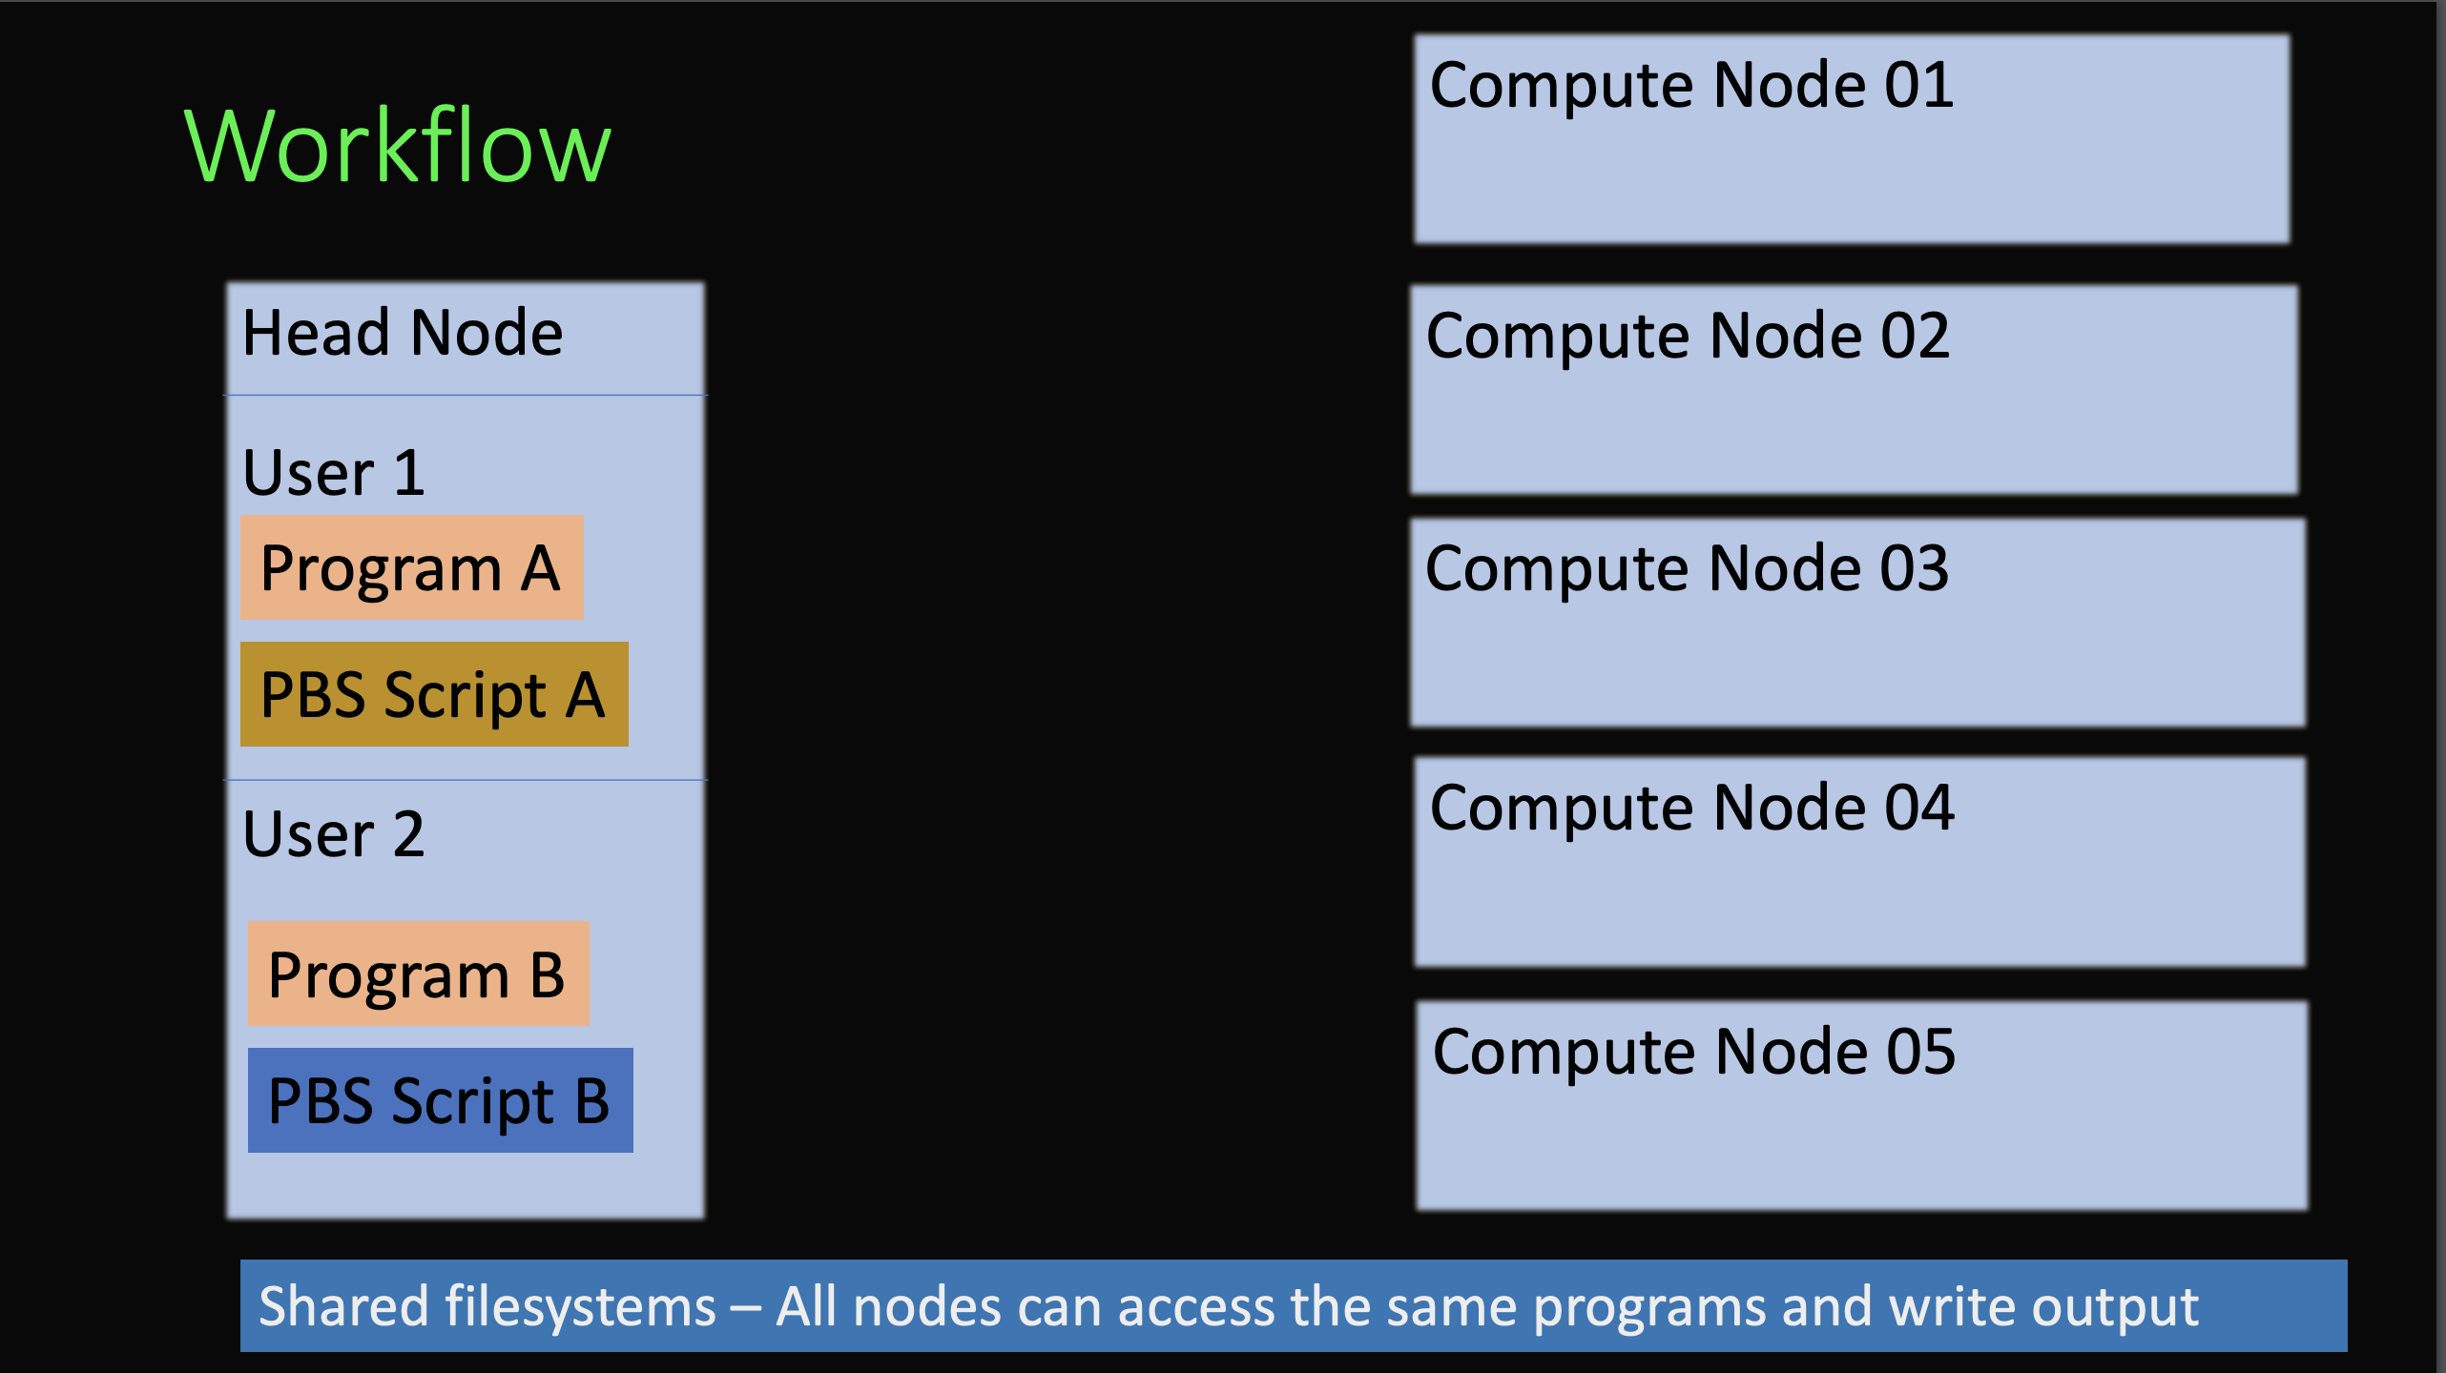

Slide 87
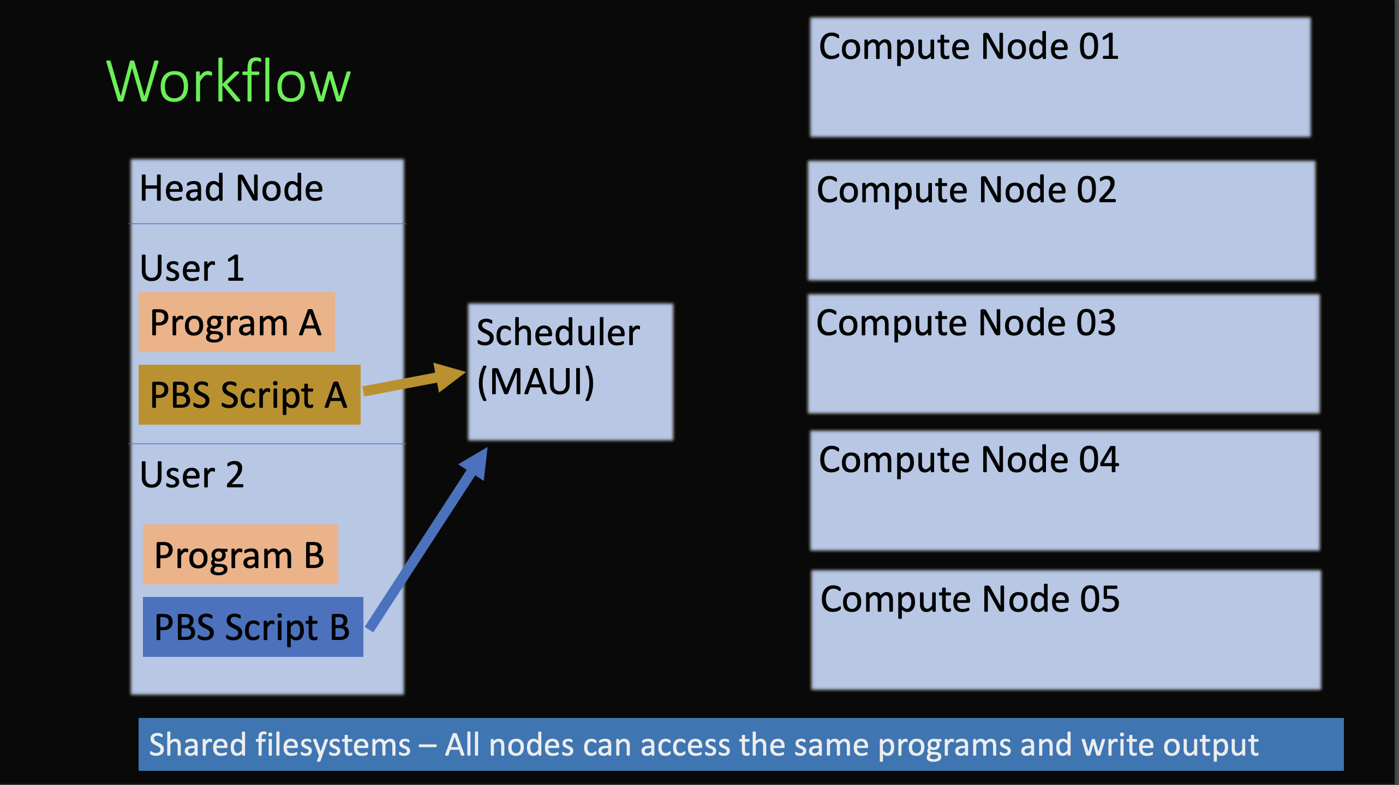
Slurm

Slide 88
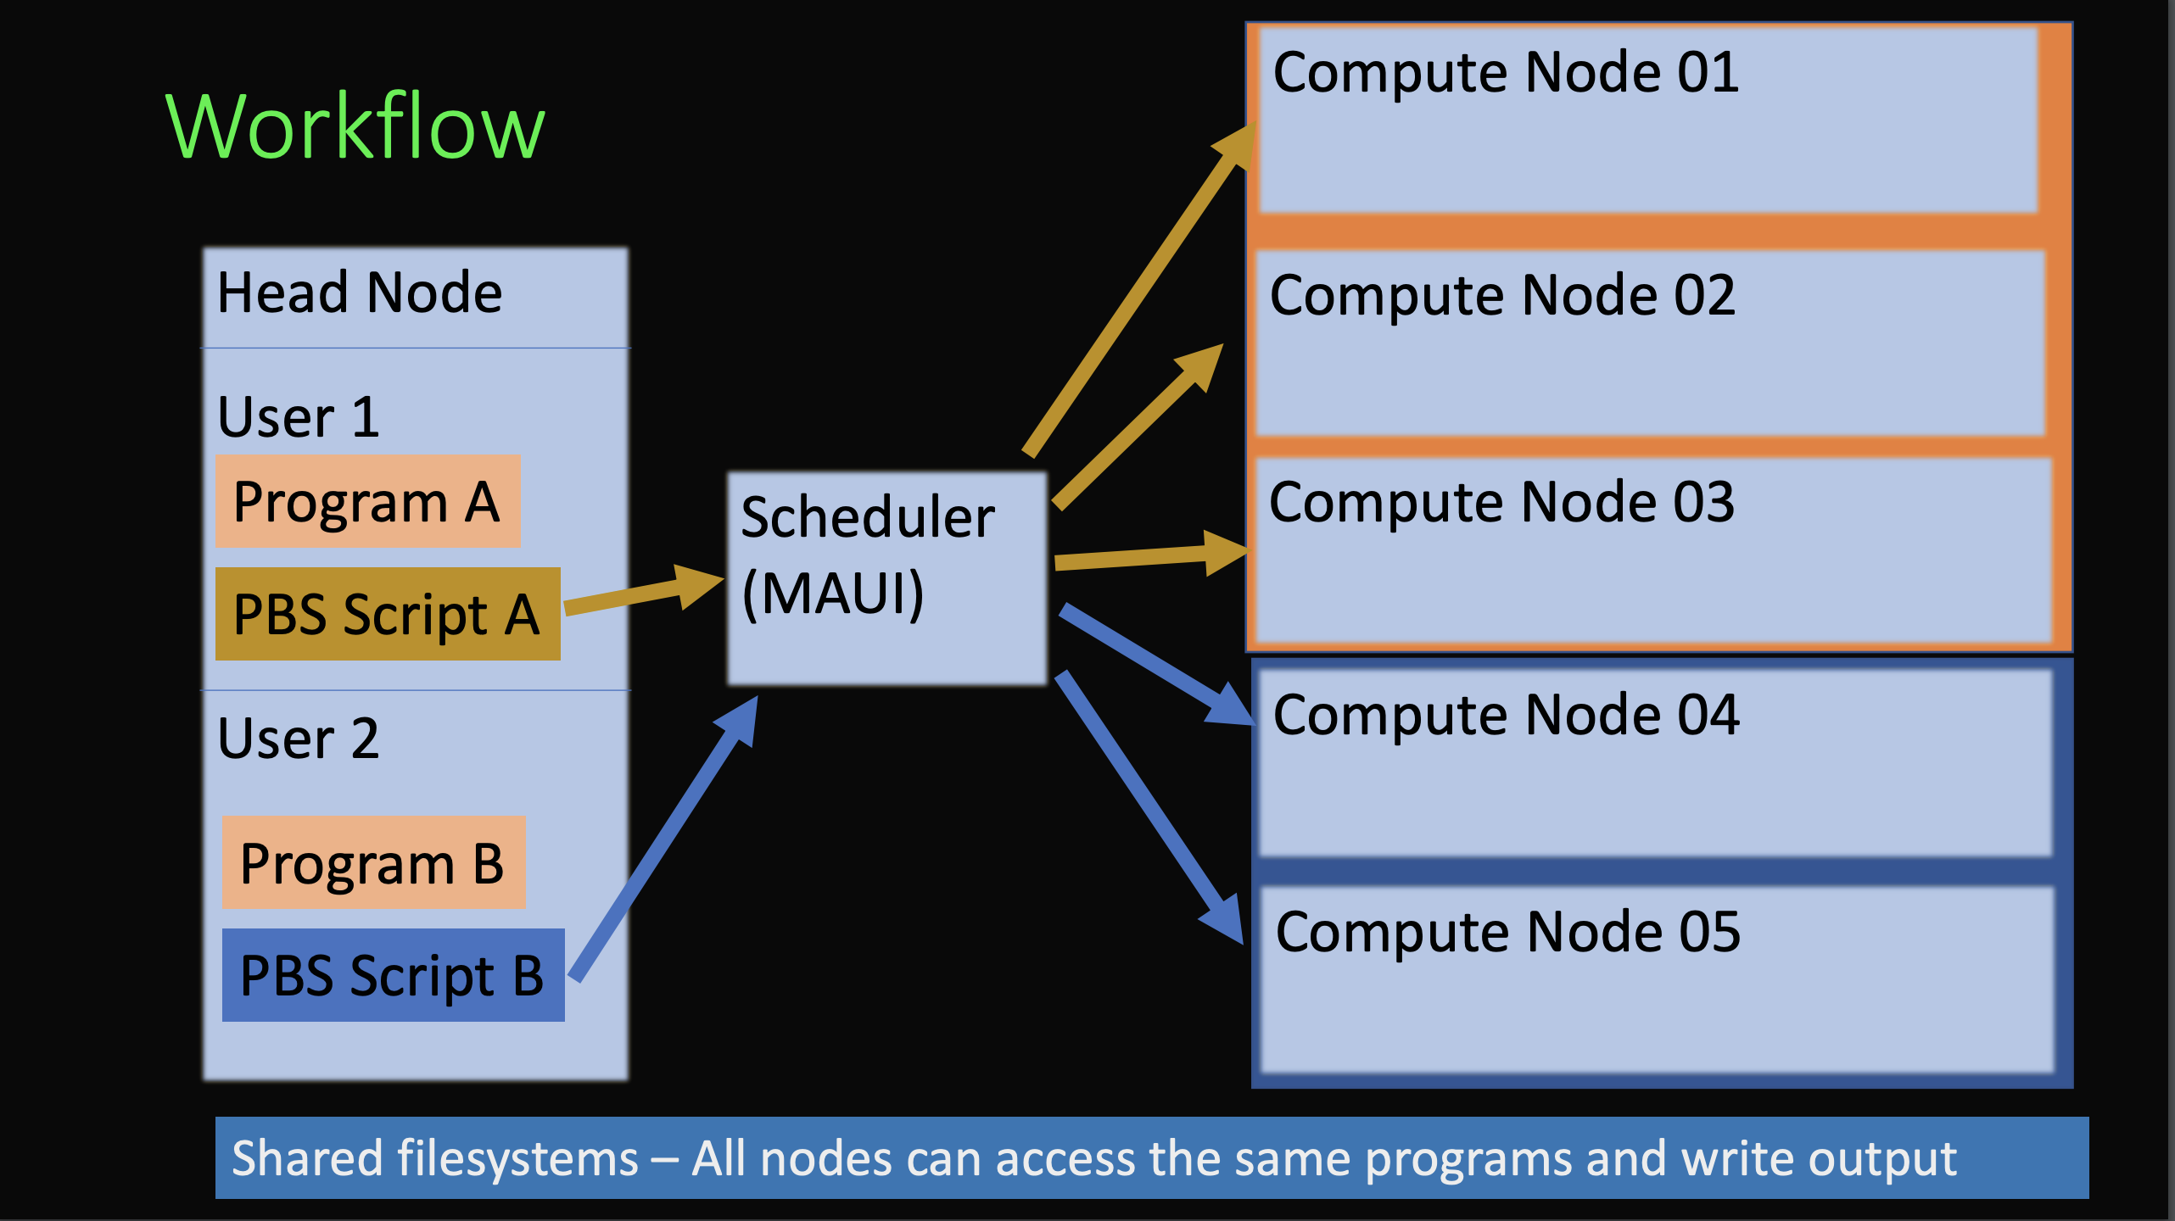
Slurm

Slide 89
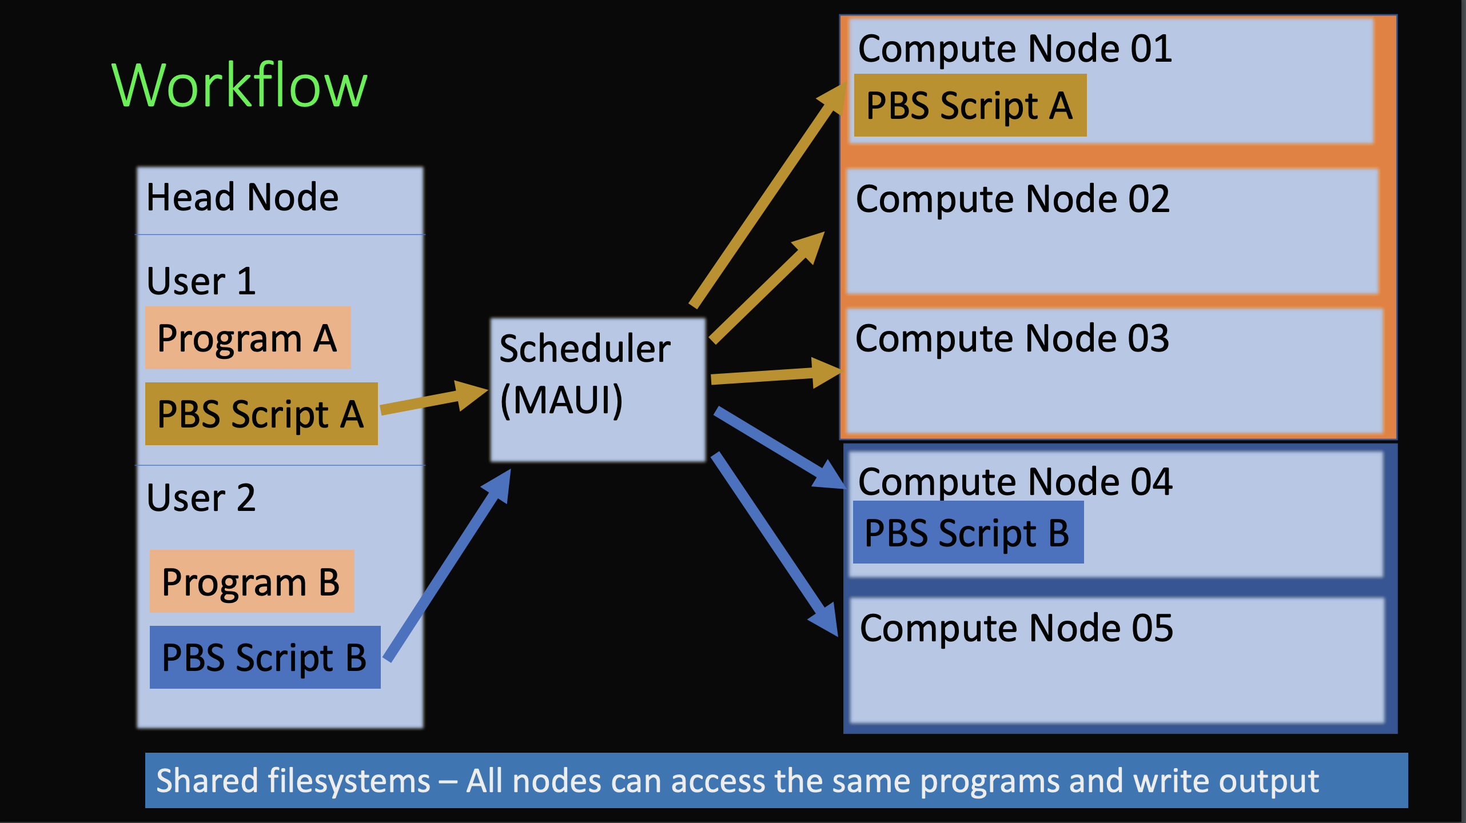
Slurm

Slide 90
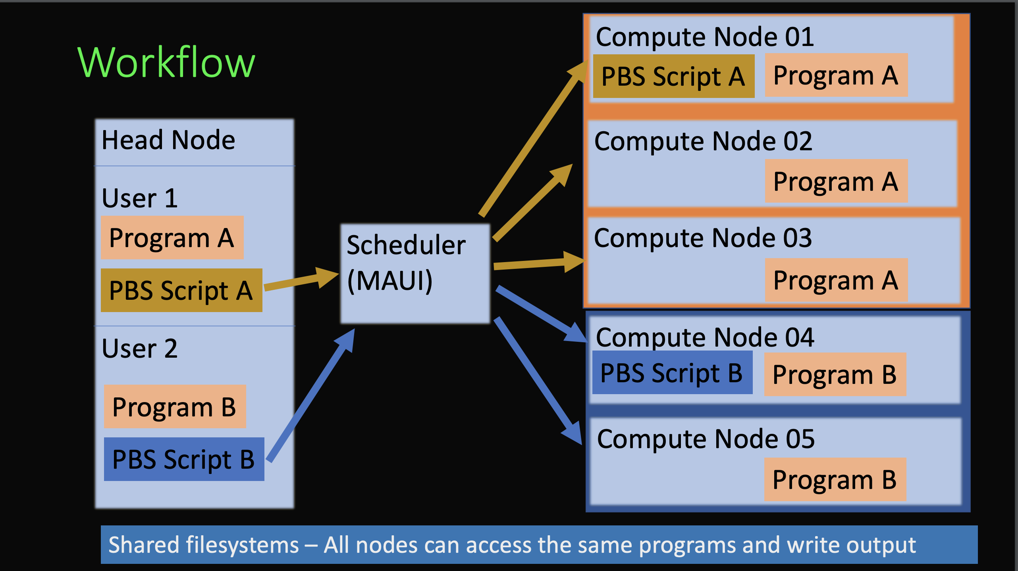
Slurm

Slide 91
Scheduler
qgrok
sbatch
squeue –u USERNAME

Slide 92
Running Programs on Compute Nodes
qgrok
Intro to the Slurm Scheduler
The srun command
sbatch
sinfo
squeue
squeue -u username --start
https://www.cism.ucl.ac.be/Services/Formations/slurm/2016/slurm.pdf
https://www.nrel.gov/hpc/assets/pdfs/slurm-advanced-topics.pdf

Slide 93
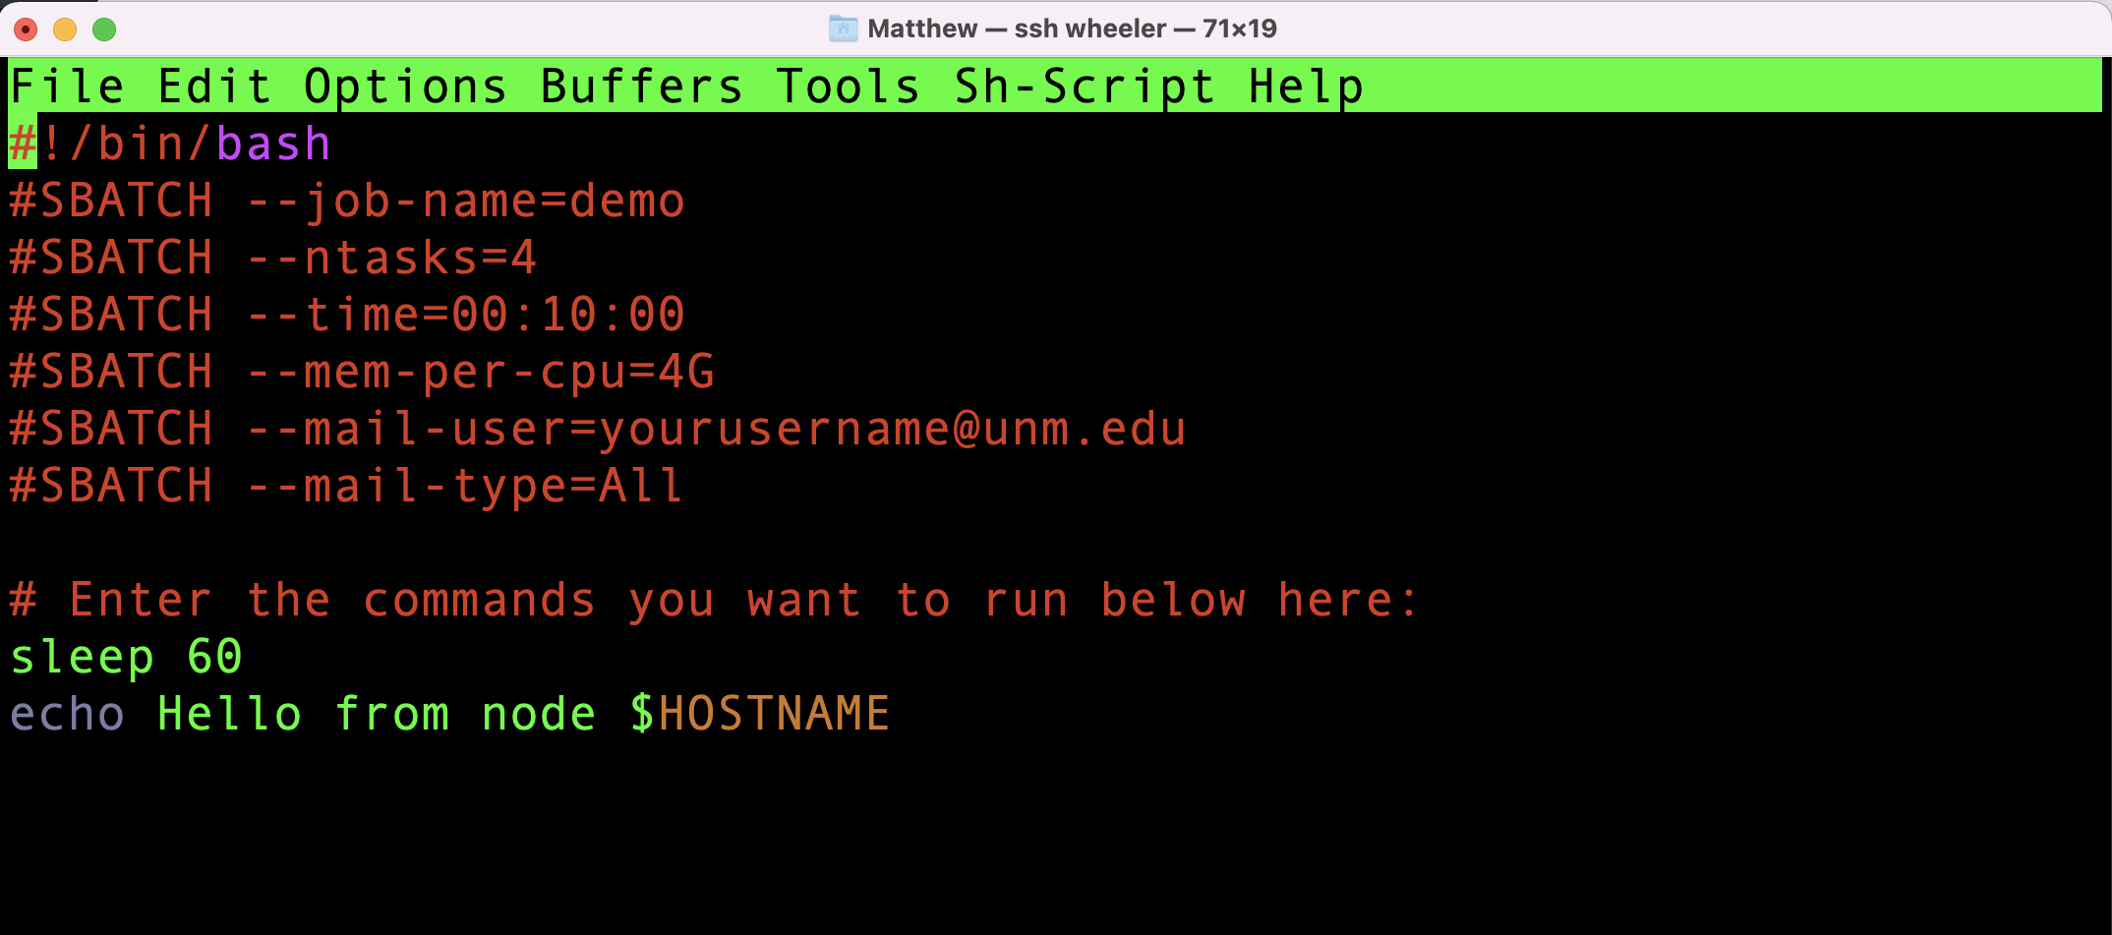
Slurm Script

Slide 94
Slurm Script
[vanilla@wheeler ~/vecadd]$ cat vecaddmpi.sh
#!/bin/bash
#SBATCH --job-name=vecaddmpi
#SBATCH --ntasks=4
#SBATCH --time=00:10:00
#SBATCH --mem-per-cpu=4G
#SBATCH --mail-user=mfricke@unm.edu
#SBATCH --mail-type=All
#SBATCH --output=vecaddmpi.out
module load openmpi/4.1.2-q2zi
srun ./vecaddmpi

Slide 95
Slurm Script
vanilla@wheeler:~/vecadd $ sbatch vecaddmpi.sh
sbatch: Using account 2016199 from ~/.default_slurm_account
Submitted batch job 167571
vanilla@wheeler:~/vecadd $ squeue --me
JOBID PARTITION NAME USER ST TIME NODES NODELIST(REASON)
167571 normal vecaddmp vanilla R 0:07 1 wheeler145

Slide 96
Slurm Script
vanilla@wheeler:~/vecadd $ tail -f vecaddmpi.out
You have not been allocated GPUs. To request GPUs, use the -G option in your submission script.
Assigning compute node to rank 1.
ComputeNode: Starting with rank 1.
ComputeNode (1): Waiting for vectors from dataserver with rank 3...
Assigning compute node to rank 2.
ComputeNode: Starting with rank 2.
ComputeNode (2): Waiting for vectors from dataserver with rank 3...
Will try to allocate a vector of size 1 GB.

Slide 97
Slurm Script
vanilla@wheeler:~/vecadd $ tail -f vecaddmpi.out
You have not been allocated GPUs. To request GPUs, use the -G option in your submission script.
Assigning compute node to rank 1.
ComputeNode: Starting with rank 1.
ComputeNode (1): Waiting for vectors from dataserver with rank 3...
Assigning compute node to rank 2.
ComputeNode: Starting with rank 2.
ComputeNode (2): Waiting for vectors from dataserver with rank 3...
Will try to allocate a vector of size 1 GB.

Slide 98
Useful Slurm Commands
squeue --me --long shows information about jobs you submitted
squeue --me --start shows when slurm expects your job to start
scancel jobid cancels a job
sacct shows your job history

Slide 99
Slurm Script
vanilla@wheeler:~/vecadd $ seff 167573
Job ID: 167573
Cluster: wheeler
User/Group: mfricke/users
State: COMPLETED (exit code 0)
Nodes: 1
Cores per node: 4
CPU Utilized: 00:01:03
CPU Efficiency: 78.75% of 00:01:20 core-walltime
Job Wall-clock time: 00:00:20
Memory Utilized: 39.55 MB (estimated maximum)
Memory Efficiency: 0.24% of 16.00 GB (4.00 GB/core)
Notes:
This is a really useful command. It is hard sometimes to know if we asked for the right number of CPUs, amount of RAM, etc for our program. If we ask for too much we are wasint resources, too little and our program will crash. “seff” – slurm efficiency reports how much of the resources our job used.

Slide 100

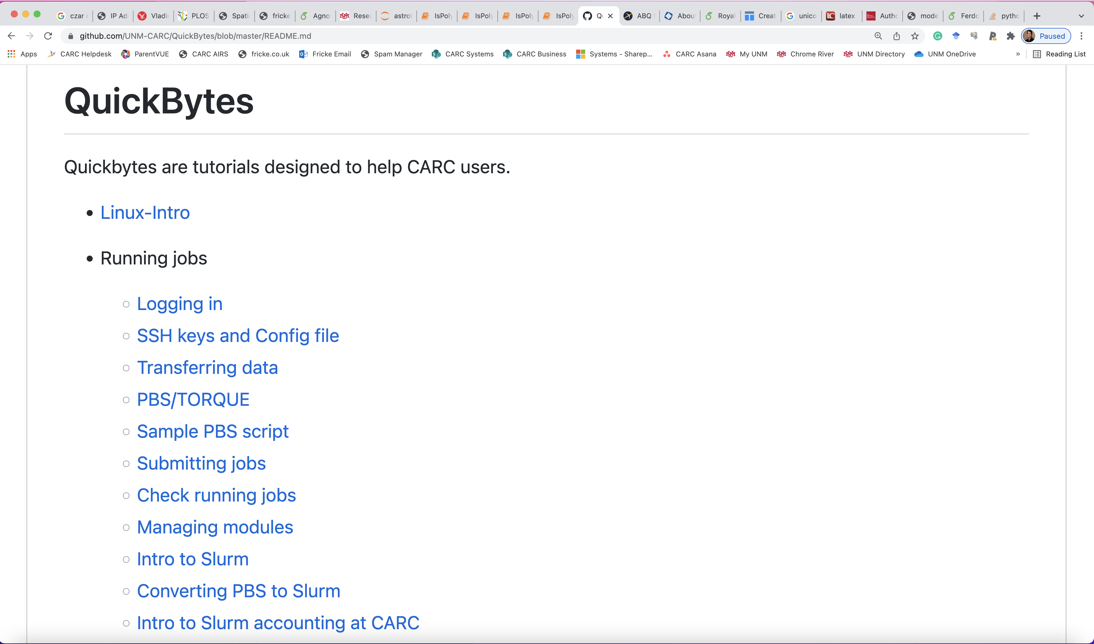
CARC Resources
Tutorial Videos
Written Tutorials

Slide 101
Getting Help
help@carc.unm.edu
Office hours

Slide 102
Bonus – sview and graphical programs

